Slide 1

Netzwerk Academy
Presented by :
Anirudh Nayak

Slide 2
Types of Machine learning
Supervised Machine Learning
Unsupervised Machine Learning
Reinfroment Machine Learning

Slide 3
Supervised Learning
In supervised learning, the computer is taught by example. It learns from past data and applies the learning to present data to predict future events.
In this case, both input and desired output data provide help to the prediction of future events.
For accurate predictions, the input data is labeled or tagged as the right answer.

Slide 4
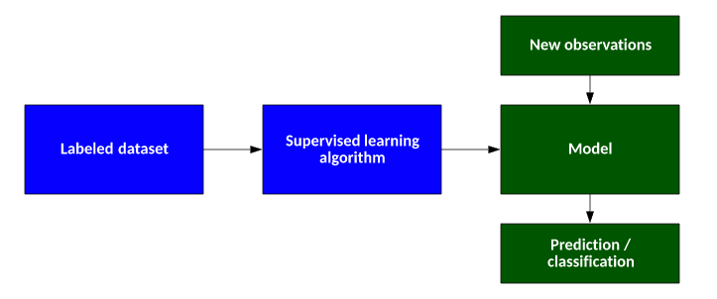

Slide 5
Types of Supervised ML
Regression Model
Regression models are used for problems where the output variable is a real value such as a unique number, dollars, salary, weight or pressure. for example. It is most often used to predict numerical values based on previous data observations.
Classification Model
Classification models are used for problems where the output variable can be categorized, such as “Yes” or “No”, or “Pass” or “Fail.” Classification Models are used to predict the category of the data. Real-life examples include spam detection, sentiment analysis, scorecard prediction of exams, etc.

Slide 6
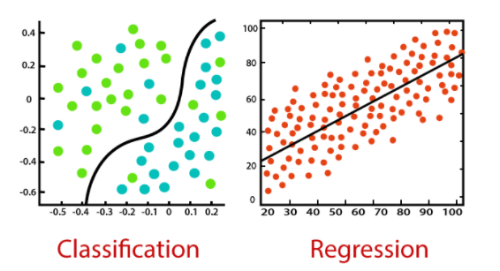

Slide 7
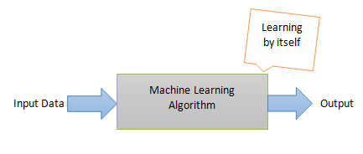
Unsupervised learning
Unsupervised learning, on the other hand, is the method that trains machines to use data that is neither classified nor labeled.
It means no training data can be provided and the machine is made to learn by itself. The machine must be able to classify the data without any prior information about the data.

Slide 8
Types of Unsupervised ML
Clustering is one of the most common unsupervised learning methods. The method of clustering involves organizing unlabelled data into similar groups called clusters.
Thus, a cluster is a collection of similar data items. The primary goal here is to find similarities in the data points and group similar data points into a cluster.

Slide 9
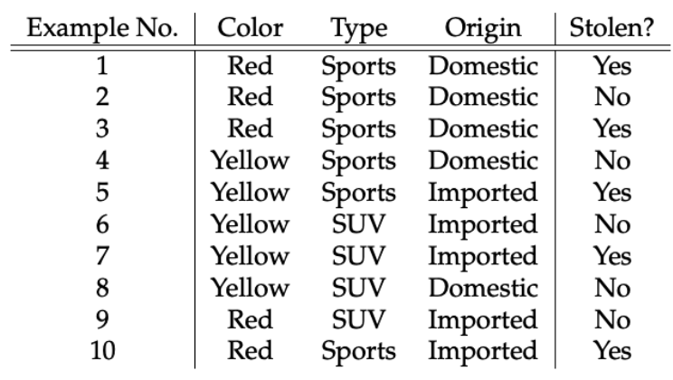
Features vs Label
Features are the input variables and these are independent of the labels hence this is independent variables
Labels are the output variables and completely depends on input variables or features hence it is dependent variable

Slide 10
Training dataset and testing dataset
A dataset can be divided into 2 parts i.e., training and testing dataset
training set is implemented to build up a model, while a test (or validation) set is to validate the model built.
In Machine Learning, we basically try to create a model to predict the test data. So, we use the training data to fit the model and testing data to test it
As you pointed out, the dataset is divided into train and test set in order to check accuracies, precisions by training and testing it on it.

